Slide 1
A Novel Method for Handwritten Digit Recognition
Project Mentor :
Mr.C.Sri Venkateswaran
Team Id:PNT2022TMID25366
Team Members:
Nimanthran Paul K
Navin Kumar M
Santhosh Kumar N
Ramanathan M

Slide 2
Contents
Problem definition
Survey Papers
Existing Application
Hardware & Software Requirements
Objective

Slide 3
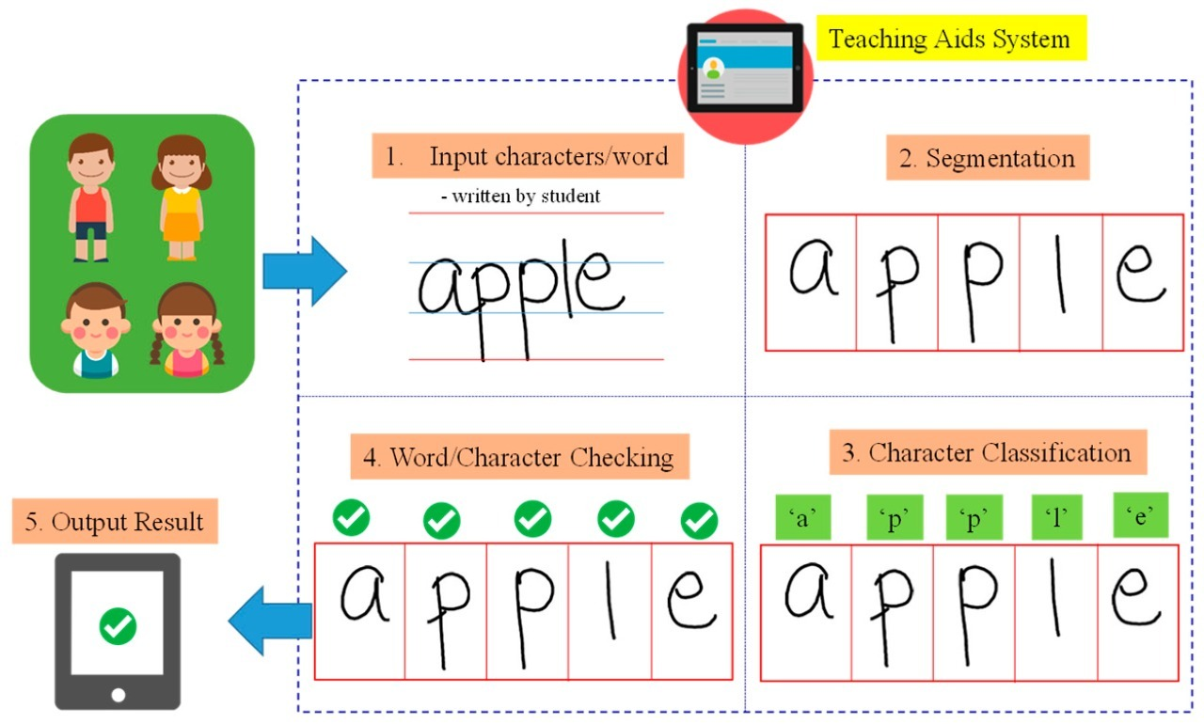
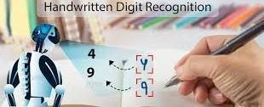
Problem definition
The process of turning handwritten writing into something that a computer can read is called handwritten character recognition (HCR). The diversity of handwriting styles, which might be radically different for different writers, is the main issue with the HCR system.
The goal of a handwritten character recognition system is to implement an easy-to-use computer assisted character representation that will enable the successful extraction of characters from handwritten documents as well as the digitalization and translation of handwritten text into machine readable text.

Slide 4
Problem definition
Architecture of the Application
1. Image Acquisition: The input image is transferred to the recognition system during the image acquisition stage. An image (JPEG, PNG, etc.), a scanned image, a digital camera, or any other approved digital input device may be used as the input.
2. Data Augmentation: 80% of the dataset is used for training and 20% is used for testing. To boost the efficiency of the model, the diversity in the data is artificially boosted using Data Augmentation. By rotating the images of the dataset to form images with different angles.
3. Splitting of dataset: The dataset is split into training and testing parts. For training, 80% of the dataset is used, and for testing, 20%.
4. Preprocessing: Character recognition begins with pre-processing, which is essential in determining the rate of recognition. The strokes are normalised during preprocessing, and any variances that can reduce accuracy rate are eliminated. Preprocessing focuses mostly on a variety of distortions, including erratic text size, points lost due to pen movement, jitters, left-to-right bend, and uneven spacing. The technique includes noise reduction, binarization, and normalisation.

Slide 5
Problem definition
Architecture of the Application
5.Segmentation: The process of segmentation divides a huge input image into discrete characters. The methods used are word, line, and character segmentation. Typically, it involves removing individual characters from a word graphic.
6. Feature Extraction: Deep learning classifies itself by extracting features using deep neural networks. As the dataset grows, its performance improves in comparison to standard techniques.
8. Classification: Using the trained dataset and CNN, the image is classified according to its attributes. When an image is fed into the Handwritten Character Recognition system, its key features are retrieved and used as inputs to the CNN classifier. It more accurately labels the featured image by comparing it to the trained dataset.
9. Taking real time user input: The model is now used to identify characters that the user writes in real time. To forecast the words that users have written, they must write on paper and upload a scanned copy of that writing.
10. Output: You get the output detailing what was written in the input image.

Slide 6
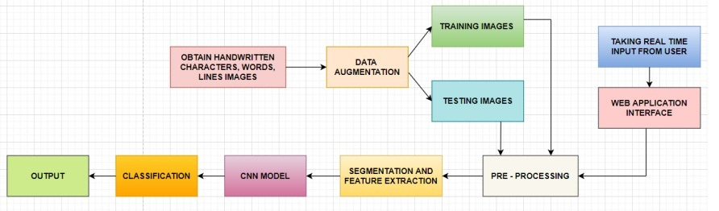
Problem definition
Architecture of the Application

Slide 7
Survey Papers
Author Name : Gaurav Surve
Title : Handwritten Character Recognition
Publication website : https://www.ijcrt.org/
Published Date : April 4, 2022
Objective : Handwritten digit recognition has a wide range of applications, including identifying postal codes on envelopes, processing largescale financial statements, and processing bank form input. It was often thought that people who used computers for business had to change their input style to match what the computer expected, whether they were typing or filling out forms with letters.
Technology used: Tensor flow - Tensor flow is the core open source library to help you develop and train Machine Learning models.

Slide 8
Existing Application
Developed by : Appsuit
Title : Handwriting to Text Converter
Publication website : https://play.google.com/store/apps/details?id=com.appsuite.handwriting.to.text
Published Date : June 14, 2022
Objective : Use the simple, yet accurate Handwriting to Text Converter app. Our OCR handwriting to text converter comes with an inbuilt scanner that quickly analyzes your handwriting and turns it into usable text.

Slide 9
Existing Application
Developed by : Globid
Title : Handwriting Recognizer
Publication website : https://play.google.com/store/apps/details?id=handwriting.to.text.convert
Published Date : 2022
Objective : This handwritten text recognition app “Handwriting Recognizer” can be both used for your personal and professional use. Just scribble the notes and later get them converted to digital text instantly. The app is very easy to use and is designed with an intuitive user interface. Get your own pocket-friendly hand recognizer app and reduce your effort to manually convert your notes into digital text.

Slide 10
De-Merits:
Since the computers have evolved, lot of research has been carried in the area of Computer and Human interface. In this Era of advanced technology, there is greater need for conversion of analog into digital.
With the advent of digital scanners and after the computer came into the scene, we have witnessed huge demand to convert books and text into digital media, viewable over the internet and on a computer .
It is a complex task to input data characters for scripts like Devanagari and Gurmukhi because they have a complex writing style. So the best possible methods to input such characters are via Hand-written documents and Speech.
Speech Recognition has some disadvantages. So the main focus of this research is Recognition of Handwritten Characters. This is where Handwritten Character Recognition comes in handy. Handwritten Character Recognition.

Slide 11
Hardware Requirements:
● Processor : Intel Core i5
● HDD: 1TB
● RAM: Minimum 2GB; Recommended 4GB
Software Requirements:
● Operating system : Windows 10
● Dataset: IAM Dataset(Words, Lines)
● Programming Language: Python
● Numpy : Core package providing powerful tools to manipulate data arrays, such as our character images.
● OpenCV : OpenCV is a large open-source library for image processing, character recognition, and machine learning. It canscan handwritten images.
● Autocorrect : It is used to correct the spelling. It supports many languages.
● Tensorflow : Tensorflow is the core open source library to help you develop and train Machine Learning models.

Slide 12
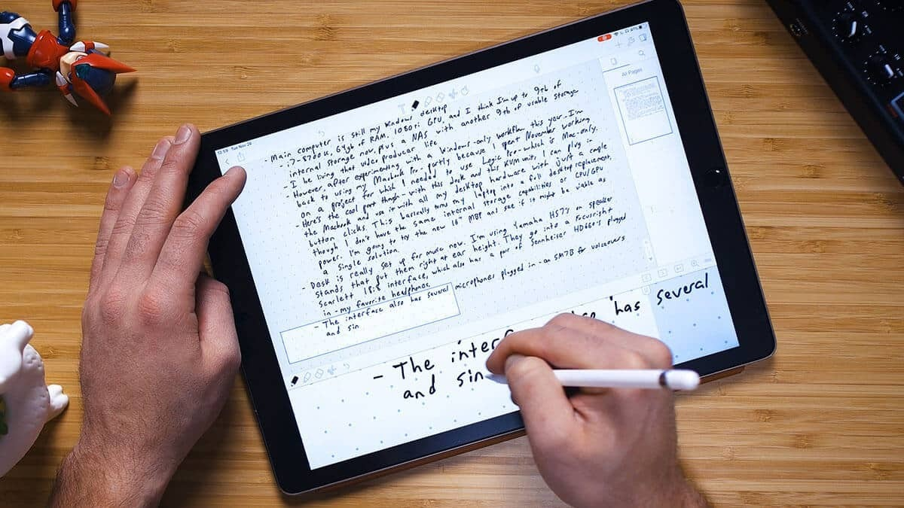
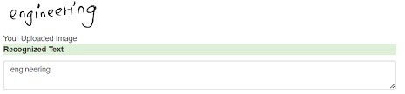
Objective:
Handwriting recognition has gained a lot of attention in the field of pattern recognition and machine learning due to its application in various fields.
Optical Character Recognition(OCR) and Handwritten Character Recognition (HCR) has specific domain to apply. Various techniques have been proposed to for character recognition in handwriting recognition system.
Even though, sufficient studies and papers describes the techniques for converting textual content from a paper document into machine readable form.
In coming days, character recognition system might serve as a key factor to create a paperless environment by digitizing and processing existing paper documents. This paper presents a detailed review in the field of Handwritten Character Recognition

Slide 13
THANK YOU

